Slide 1

TKR COLLEGE OF ENGINEERING AND TECHNOLOGY
(Autonomous, Accredited by NAAC with ‘A’ Grade)
Department of Computer Science & Engineering
B. Tech IV Year II Semester
Project Part B

Slide 2
REVIEW - 4

Slide 3
PROJECT GUIDE:
Dr. CHAGANTI B N LAKSHMI
TEAM DETAILS:
ROLL.NO | STUDENT NAME
19K91A0549 | CH SRIJAN (Team Leader)
19K91A05O5 | AFSHA
19K91A0506 | AILA VIGNESH
19K91A0555 | DAMERA RAJU

Slide 4
PROJECT TITLE
A MODEL TO PREDICT HEART DISEASE USING MACHINE LEARNING
TEAM NO : A9
BRANCH/SEC : CSE-A

Slide 5
CODING

Slide 6
DATASET
MULTIVARIATE IMPUTATION BY CHAINED EQUATION(MICE)
FEATURE SELECTION
STANDARD SCALAR
SYNTHETIC MINORITY OVER-SAMPLING TECHNIQUES(SMOTE)
MODEL CONSTRUCTION
ACCURACY
PREDICTION
CONTENTS

Slide 7
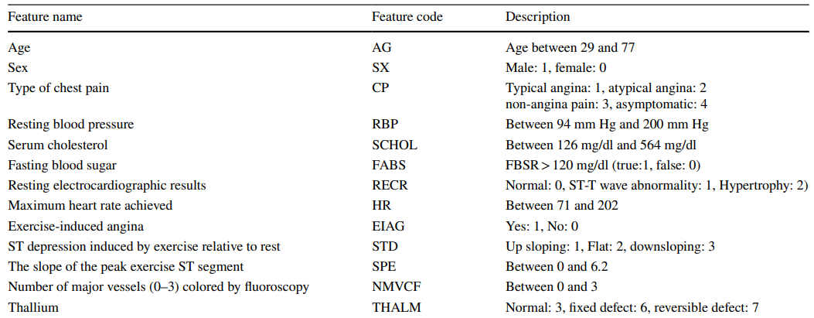
1.DATASET
Cleveland Heart disease dataset
This dataset contains Heart Disease Data collected obtained from UCI (University of California, Irvine).
This dataset is having 14 features out of which eight are categorical features and six are numeric features.
Data of patients having age from 29 to 77 are collected in this dataset

Slide 8
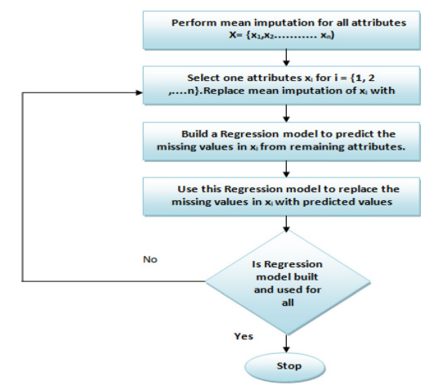
2. MULTIVARIATE IMPUTATION BY CHAINED EQUATION(MICE)
Cleveland dataset has six missing values. These Missing values were imputed using MICE algorithm. This algorithm performs imputation multiple times. It assumes that data is missing randomly. In this method, a regression model is used to predict the value of the missing attribute from the remaining attributes of the dataset

Slide 9
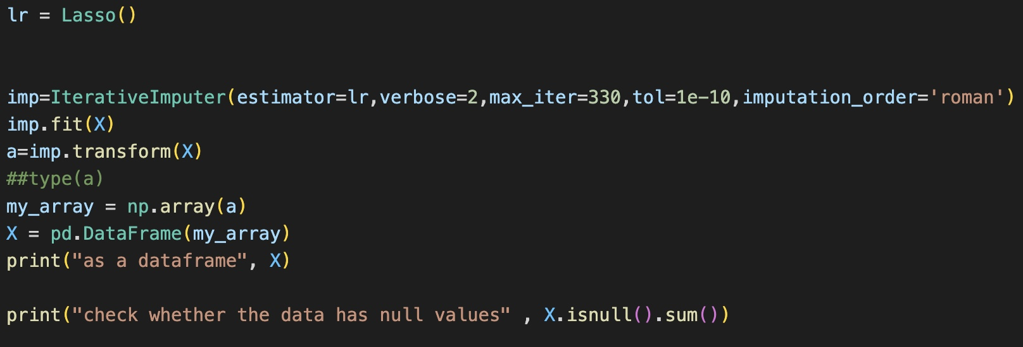
MICE CODE:

Slide 10
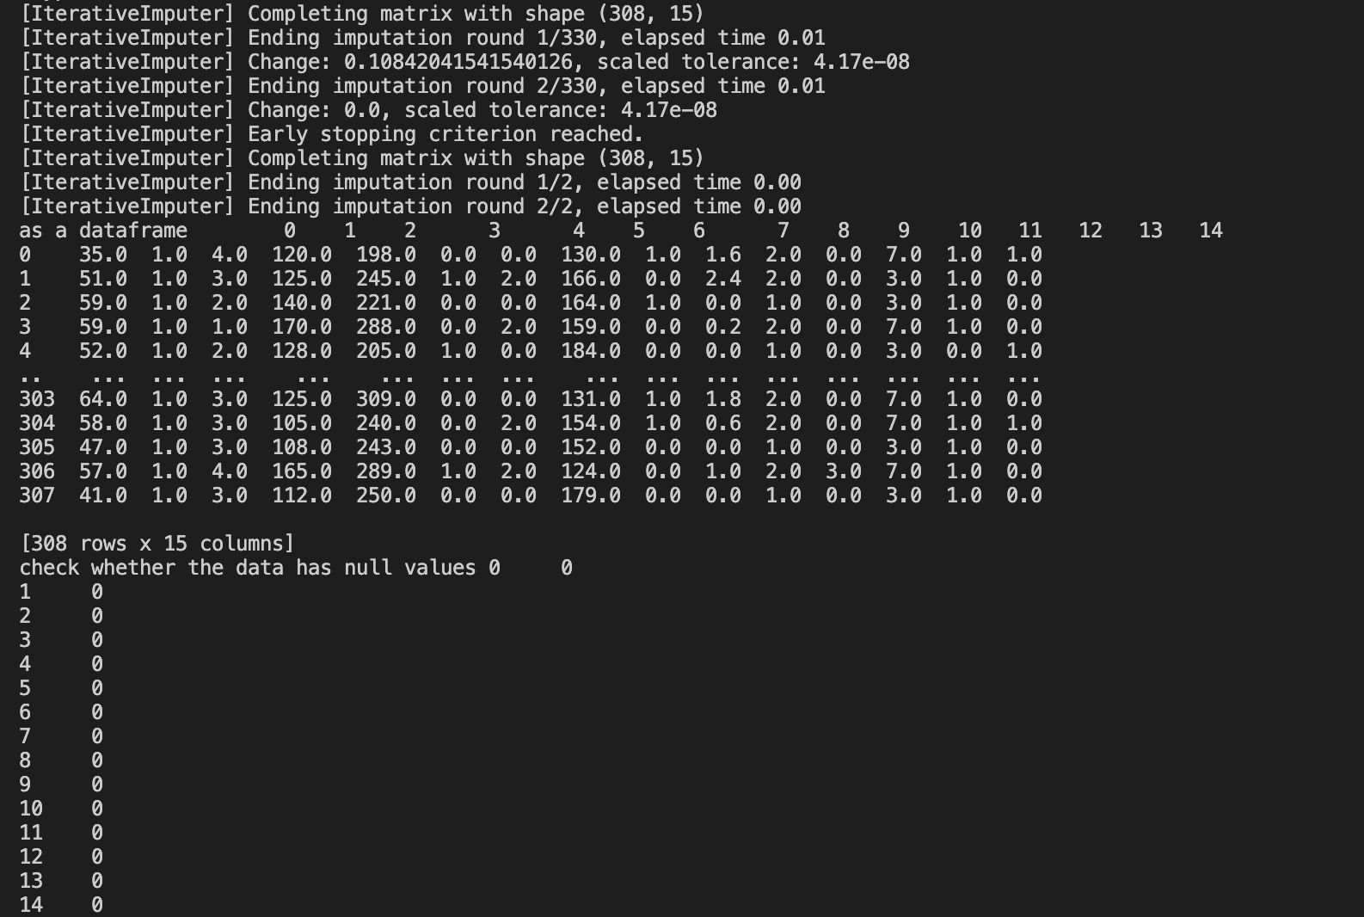
MICE O/P:

Slide 11
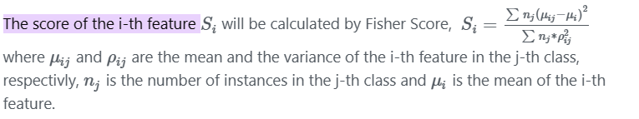
3.FEATURE SELECTION

Slide 12
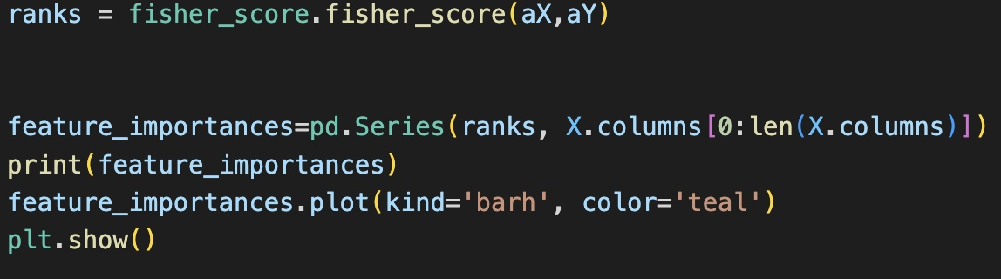
Fisher Score Code:

Slide 13
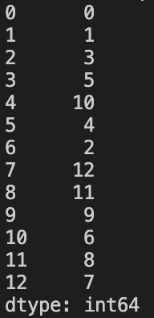
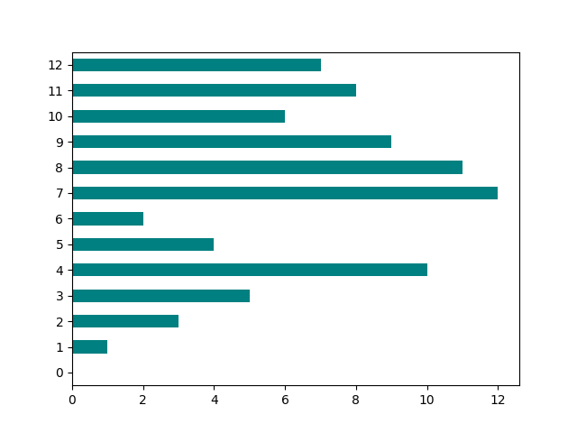
Fisher Score O/P:

Slide 14
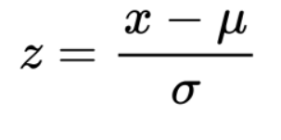
4. STANDARD SCALAR
Scaling of Features is an essential step in modeling the algorithms with the datasets. The data that is usually used for the purpose of modeling is derived through various means
Standardization is a scaling technique wherein it makes the data scale-free by converting the statistical distribution of the data into the below format
mean - 0 (zero)
standard deviation – 1

Slide 15
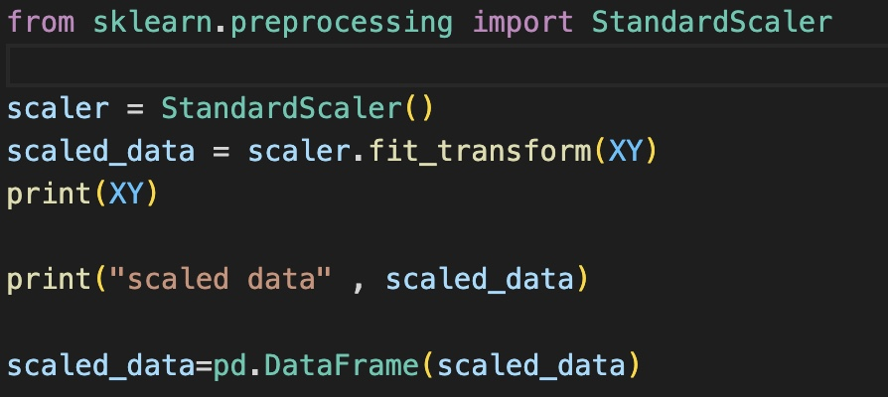
STANDARD SCALAR CODE:

Slide 16
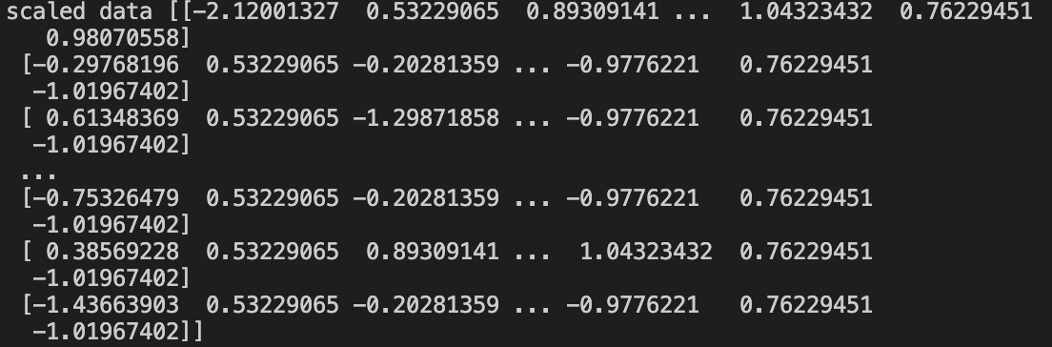
STANDARD SCALAR O/P:

Slide 17
5. SYNTHETIC MINORITY OVER-SAMPLING TECHNIQUES(SMOTE)
SMOTE: a powerful solution for imbalanced data.
Accuracy is a bad machine learning metric when working with imbalanced data.
Few Methods for class imbalance.
UnderSampling:
OverSampling:
Data Augmentation:
SMOTE is an algorithm that performs data augmentation by creating synthetic data points based on the original data points. SMOTE can be seen as an advanced version of oversampling, or as a specific algorithm for data augmentation. The advantage of SMOTE is that you are not generating duplicates, but rather creating synthetic data points that are slightly different from the original data points.

Slide 18
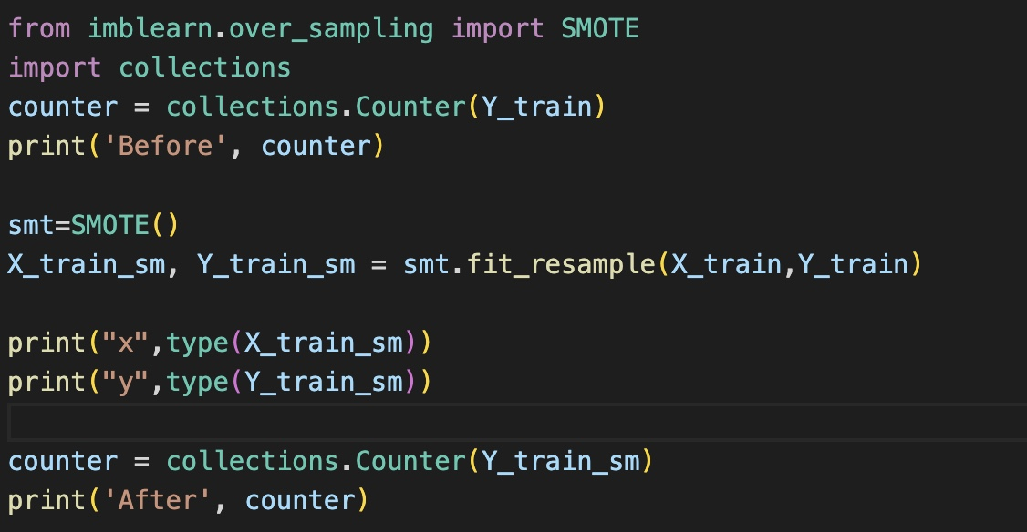
SMOTE CODE:

Slide 19
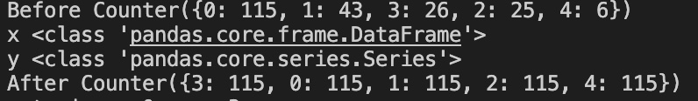
SMOTE O/P:

Slide 20
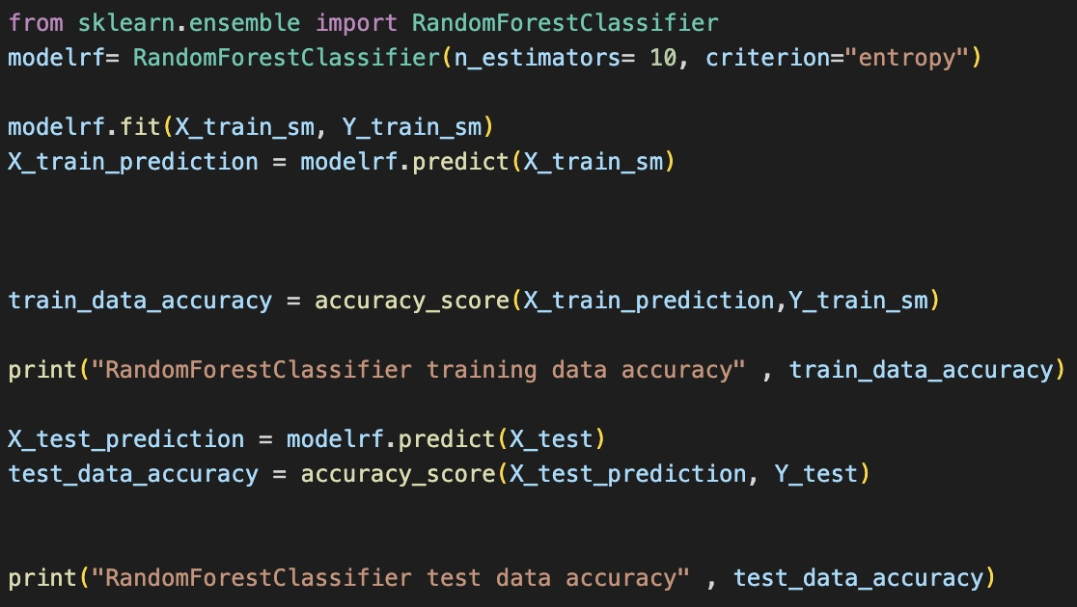
6. MODEL CONSTRUCTION
RANDOM FOREST

Slide 21
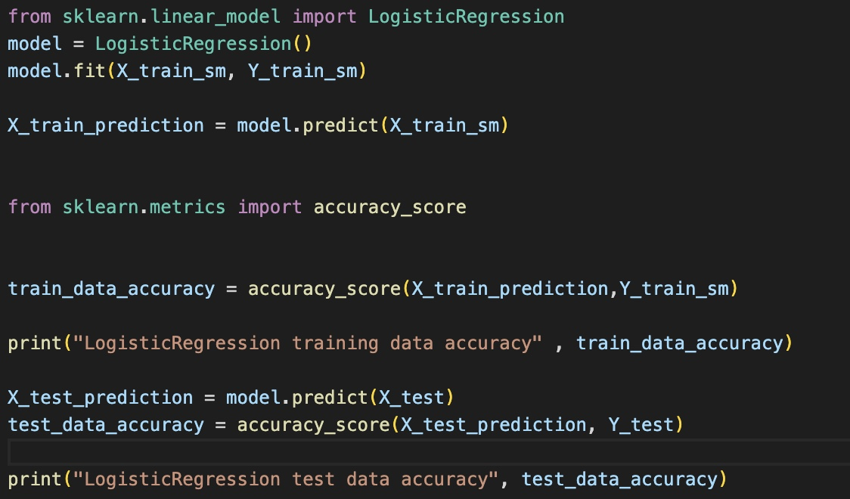
LOGISTIC REGRESSION

Slide 22
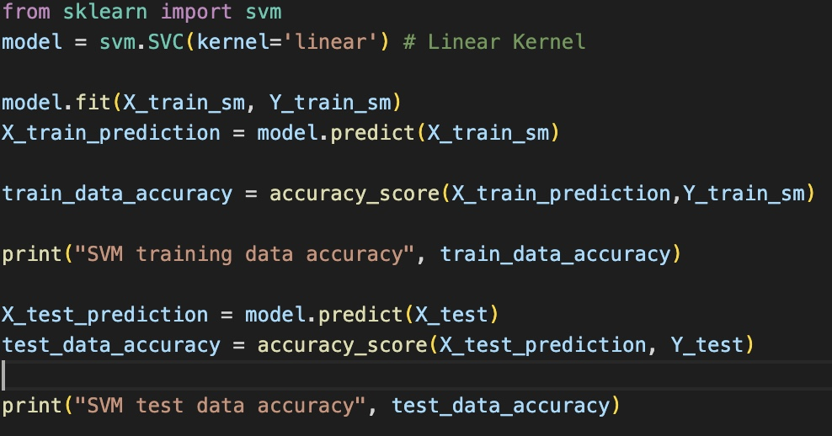
SUPPORT VECTOR MACHINE

Slide 23
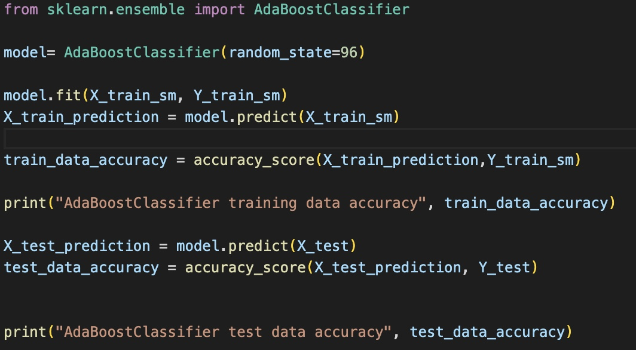
ADABOOST

Slide 24
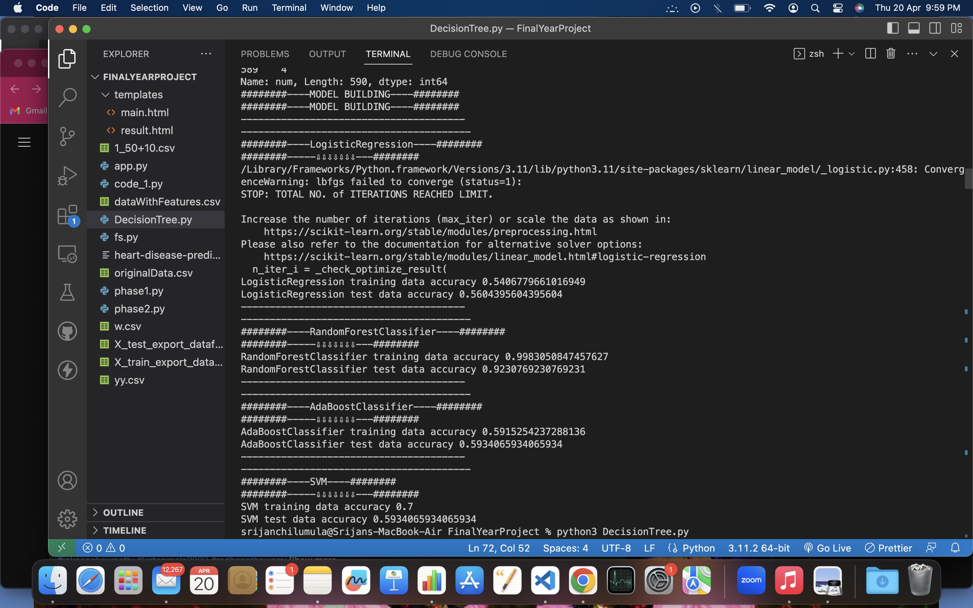
7. ACCURACY

Slide 25
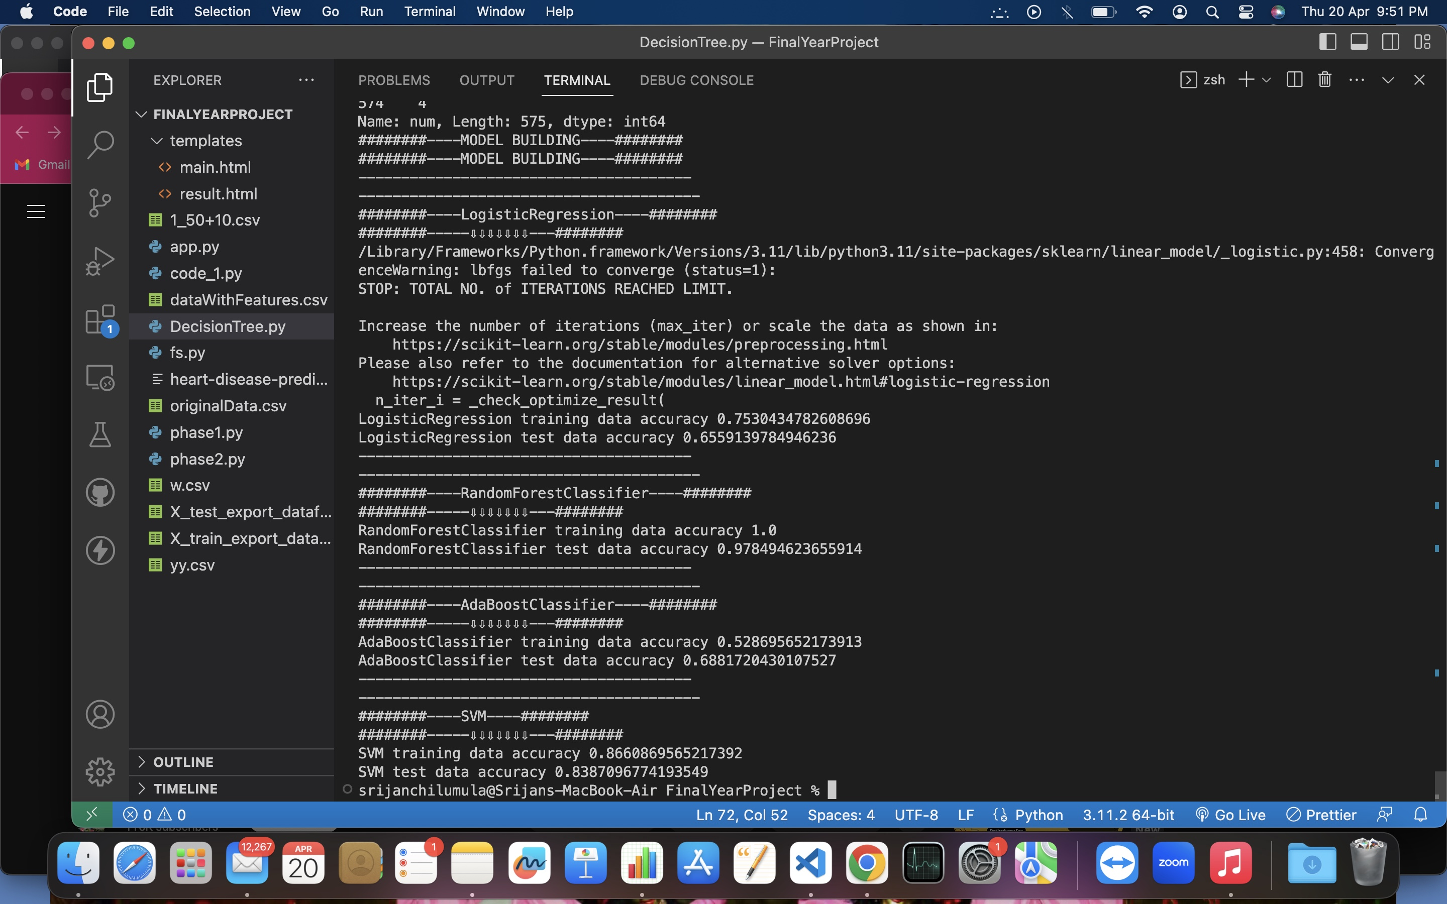
7. ACCURACY

Slide 26
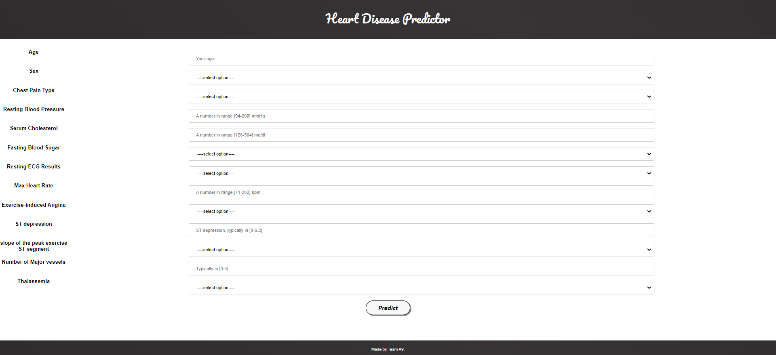
8. PREDICTION

Slide 27
THANK YOU

